Slide 1

UNIVERSITY INSTITUTE OF ENGINEERING
COMPUTER SCIENCE ENGINEERING
Machine Learning
23CSH-651
By
Dr. Meena Pundir
INTRODUCTION
DISCOVER . LEARN . EMPOWER

Slide 2
Bayesian learning

Slide 3
Supervised learning for two classes
We are given n training samples (x_{i},y_{i}) for i=1..n drawn i.i.d from a probability distribution P(x,y).
Each x_{i} is a d-dimensional vector ( ) and y_{i} is +1 or -1
Our problem is to learn a function f(x) for predicting the labels of test samples x_{i}’ (in R^{d} ) for i=1..n’ also drawn i.i.d from P(x,y)

Slide 4
Classification: Bayesian learning
Bayes rule:
To classify a given datapoint x we select the model (class) M_{i} with the highest P(M_{i}|x)
The denominator is a normalizing term and does not affect the classification of a given datapoint. Therefore
P(x|M) is called the likelihood and P(M) is the prior probability. To classify a given datapoint x we need to know the likelihood and the prior.
If priors P(M) are uniform (the same) then finding the model that maximizes P(M|D) is the same as finding M that maximizes the likelihood P(D|M).

Slide 5
Maximum likelihood
We can classify by simply selecting the model M that has the highest P(M|D) where D=data, M=model. Thus classification can also be framed as the problem of finding M that maximizes P(M|D)
By Bayes rule:

Slide 6
Maximum likelihood
Suppose we have k models to consider and each has the same probability. In other words we have a uniform prior distribution P(M)=1/k. Then
In this case we can solve the classification problem by finding the model that maximizes P(D|M). This is called the maximum likelihood optimization criterion.

Slide 7
Maximum likelihood
Suppose we have n i.i.d. samples (xi,yi) drawn from M. The likelihood P(D|M) is
Consequently the log likelihood is

Slide 8
Maximum likelihood and empirical risk
Maximizing the likelihood P(D|M) is the same as maximizing log(P(D|M)) which is the same as minimizing -log(P(D|M))
Set the loss function to
Now minimizing the empirical risk is the same as maximizing the likelihood (return to this later again)

Slide 9
Maximum likelihood example
Consider a set of coin tosses produced by a coin with P(H)=p (P(T)=1-p)
We want to determine the probability P(H) of the coin that produces k heads and n-k tails?
We are given some tosses (training data): HTHHHTHHHTHTH.
Solution:
Form the log likelihood
Differentiate w.r.t. p
Set to the derivative to 0 and solve for p

Slide 10
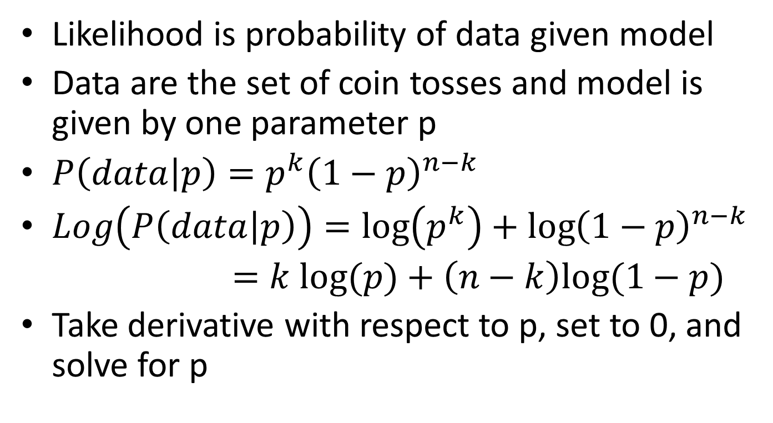
Maximum likelihood example

Slide 11
Classification by likelihood
Suppose we have two classes C₁ and C₂.
Compute the likelihoods P(D|C₁) and P(D|C₂).
To classify test data D’ assign it to class C₁ if P(D|C₁) is greater than P(D|C₂) and C₂ otherwise.

Slide 12
Gaussian models
Assume that class likelihood is represented by a Gaussian distribution with parameters μ (mean) and σ (standard deviation)
We find the model (in other words mean and variance) that maximize the likelihood (or equivalently the log likelihood). Suppose we are given training points x₁,x₂,…,x_{n1} from class C₁. Assuming that each datapoint is drawn independently from C₁ the sample log likelihood is

Slide 13
Gaussian models
The log likelihood is given by
By setting the first derivatives dP/dμ₁ and dP/dσ₁ to 0. This gives us the maximum likelihood estimate of μ₁ and σ₁ (denoted as m₁ and s₁ respectively)
Similarly we determine m₂ and s₂ for class C₂.

Slide 14
Gaussian models
After having determined class parameters for C1 and C2 we can classify a given datapoint by evaluating P(x|C1) and P(x|C2) and assigning it to the class with the higher likelihood (or log likelihood).
The likelihood can also be used as a loss function and has an equivalent representation in empirical risk minimization (return to this later).

Slide 15
Gaussian classification example
Consider one dimensional data for two classes (SNP genotypes for case and control subjects).
Case (class C₁): 1, 1, 2, 1, 0, 2
Control (class C₂): 0, 1, 0, 0, 1, 1
Under the Gaussian assumption case and control classes are represented by Gaussian distributions with parameters (μ₁, σ₁) and (μ₂, σ₂) respectively. The maximum likelihood estimates of means are

Slide 16
Gaussian classification example
The estimates of class standard deviations are
Similarly s₂=.25
Which class does x=1 belong to? What about x=0 and x=2?
What happens if class variances are equal?

Slide 17
Multivariate Gaussian classification
Suppose each datapoint is an m-dimensional vector. In the previous example we would have m SNP genotypes instead of one. The class likelihood is given by
Where Σ₁ is the class covariance matrix. Σ₁ is of dimensiona d x d. The (i,j)^{th} entry of Σ₁ is the covariance of the i^{th} and j^{th} variable.

Slide 18
Multivariate Gaussian classification
The maximum likelihood estimates of η₁ and Σ₁ are
The class log likelihoods with estimated parameters (ignoring constant terms) are

Slide 19
Multivariate Gaussian classification
If S₁=S₂ then the class log likelihoods with estimated parameters (ignoring constant terms) are
Depends on distance to means.

Slide 20
Naïve Bayes algorithm
If we assume that variables are independent (no interaction between SNPs) then the off-diagonal terms of S are zero and the log likelihood becomes (ignoring constant terms)

Slide 21
Nearest means classifier
If we assume all variances s_{j} to be equal then (ignoring constant terms) we get

Slide 22
Gaussian classification example
Consider three SNP genotype for case and control subjects.
Case (class C₁): (1,2,0), (2,2,0), (2,2,0), (2,1,1), (0,2,1), (2,1,0)
Control (class C₂): (0,1,2), (1,1,1), (1,0,2), (1,0,0), (0,0,2), (0,1,0)
Classify (1,2,1) and (0,0,1) with the nearest means classifier

